Slide 1
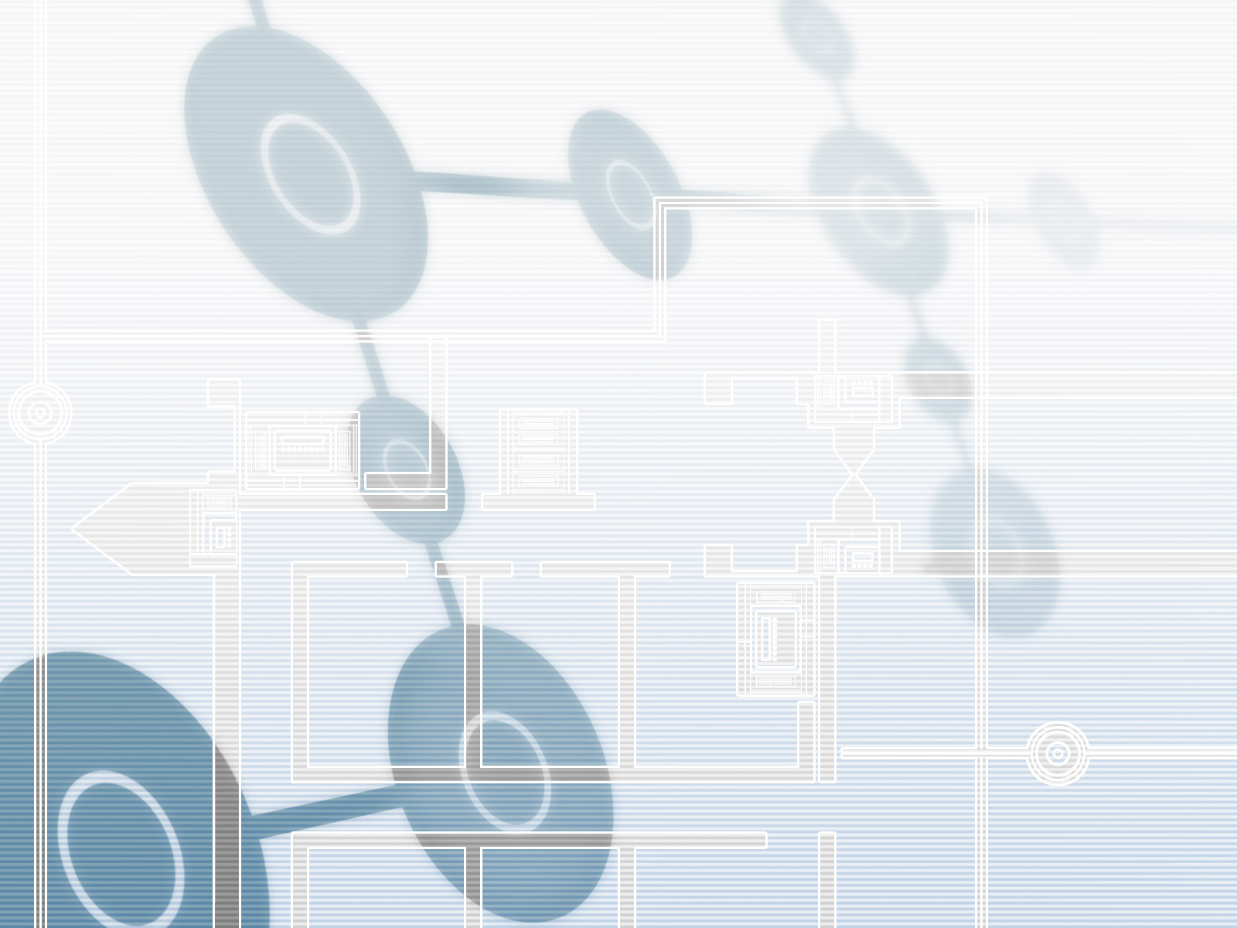
Household Energy Consumption Management or Monitoring
Jigme Thinley
MSc. Student,
UNIVERSITY OF SALZBURG, AUSTRIA

Slide 2
Objectives
Designed the smart system to monitor and manage the power consumption of each electronic devices installed at home.
The smart devices will be installed to control the energy consumption of each devices as per ones need and make the data available to Aggregator/Agent to share information to end users or in distributed computing.
The Sensor Information will be made available via through appliances- smart phone- Aggregator as a data agent enabled and data is distributed in the cloud computing.
Public awareness and information will be shared such as like how much energy consumped by the concern friends have used will be compared in a hourly/daily or week/month at his apartment via through social media such as like facebook and etc.
The game options will be enabled if such and such friends of circle who achives to use the minimum energy level in a month or week (Foursquare) will be rewarded with prices and badges.
The mobile users can even remotely check the enery consumed or they can install plugin to receive some alert message about the energy consumption rate of household
Here i have assumed smart phone and aggregator existing in different and performing specfic task.
The aggregator will do mapping and data representation in an intelligent process – specfic task.
Even the smart phone can control the sensor applainces remotely.

Slide 3
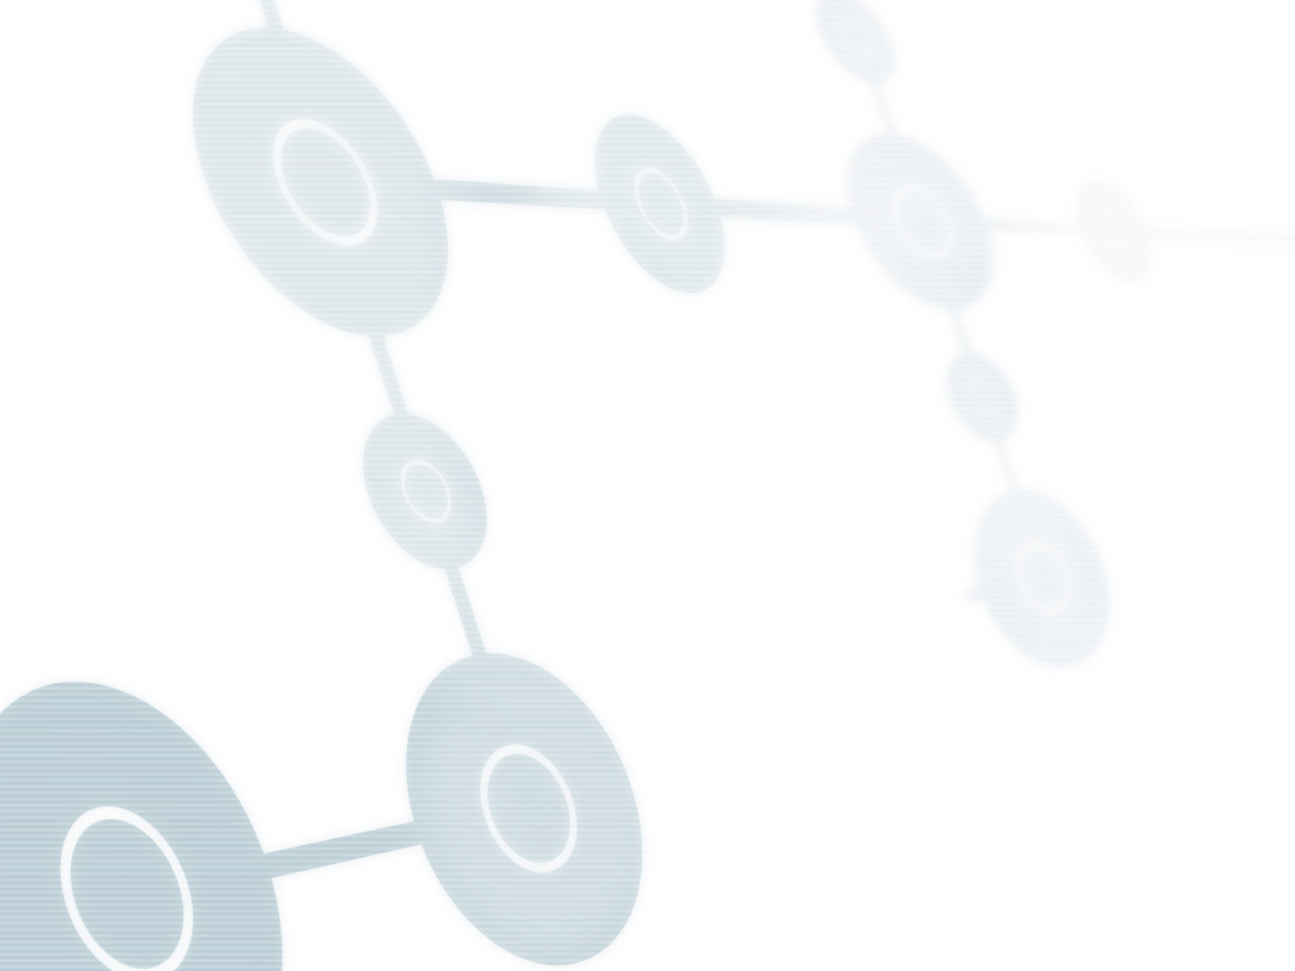
Fundamental Principle
Energy Consumed by Household Appliances.
  1. User can download Face book application and install in their Face book interface for calculating the energy or power consumption of household, based on the activities energy used, such as cooking, cleaning, lighting etc. However, the smart device will monitor the energy consumption of each device so that each house hold can easily control the energy consumption level of respective appliances.
  2. The Aggregator with embedded enabled system can calculate the energy consumption rate within a day(s), week(s), and for a month(s).
  3. The Aggregator system will have a provision of displaying the real time power consumption of appliances via through distributed computing or mobile devices with more graphical view and enabling users to interact and use the sensor data everywhere – creating awareness to lower the consumption of energy
  4. The overall idea of this application is to use the energy efficiently, and cut down the cost, and minimize the energy consumption so that you have least impact on the global warming related problem.

Slide 4
Review of the Existing System
1 : Pachube : The Pachube is acting like an agent/aggregator enabling the on-line database service allowing developers to connect sensor-derived data to the Web and to build their own applications based on that data – e.g. household energy consumption rate. [https://pachube.com/]
2. Opower : the details of how you use energy and how you can save energy. It give us as much access as possible to information about our energy use. Thereby we will be able to save energy and save money.[http://opower.com]
3. The above two (2) agents are playing a very important role in managing the energy consumption. It has efficient online database which enables users to use data or connect to web to manage the ones energy consumption rate efficiently.
4. By incorporating the software to monitor the rate of energy consumption it will enable the users to control and create awareness. Which ultimately will reduce the cost and manpower to manage the fast growing utility of managing the utility appliances in daily life.

Slide 5
The System Criteria
Mobile Installation : Main Menu consist of 4 options (on mobile device)
  1.Start : When user press the start button, user activation will be prompted to mobile device. The botton will automatically display the following options.
    Power Saved : How much power you have saved in a day/week/month
    Energy Consumed : How much energy you have consumed energy in a day/week/month
    Cost : How much you paid for the power consumed energy in a day/week/month
  2.Reduce : Review energy consumed and also calculate the energy your household appliances consumed recently with power output you have used.
  3. Offset : Why your collecting the information of energy consumed in household.
  4. Stop&Exit : Stop monitoring and Exit from the system.
Household Appliances: The energy consumption calculation is based on the summary of the energy used in household. The result is shown below for day(s) week(s) and for a month (s).

Slide 6


Funtional Design Criteria
Smart Phone/GPS/GPRS/WIMAX Enabled
APPLICATION ON MOBILE
INSTALLATION APP.
Mobile Device
Social Network
FACEBOOK
Post and Game on Foursquare/Facebook/ on Social Media
Energy Consumption of Household Calculation
Facebook connection/Mobile installation
GUI,Calculation DisplayPanel,Energy Consumption Awareness
Start
Reduce
Offset
Exit
Power Saved
Energy Consumed
Cost
Display the information why your collecting the information about Energy Consumption
Calculate energy consumed
Output the power you have used
Find to reduce the energy consumption rate
Household Appliances
Main Power Supplier
Aggregator
The aggregator will fetch data automatically from smart phone and those sensor data will be graphically shared to social media.
Note : here mobile devices are assumed smart enabled one and aggregator has enabled embedded system option to do things intelligently to pop the information anytime.

Slide 7
Functional Design Criteria
Household Appliances : Includes Washing Machine, Thermostat, Cooking Appliances (Micro-oven) and etc, Computer/Laptop, Tube light and Bulb (in rooms), and etc – all appliances are integrated with sensor chips to communicate with Smart Phone (The energy consumed are calculated hourly/daily/weekly/monthly).
The household appliances (sensor enabled) are connected to smart phone which auto controls the energy consumption at home.
The aggregator here is assumed to be residing in cloud where it has a special software developed to communicate with smart phone (sensor data collected from appliances). The aggregator acts here like an embedded system that can further process the data analysis in more powerful way and it can reach the data to any where, everywhere.

Slide 8
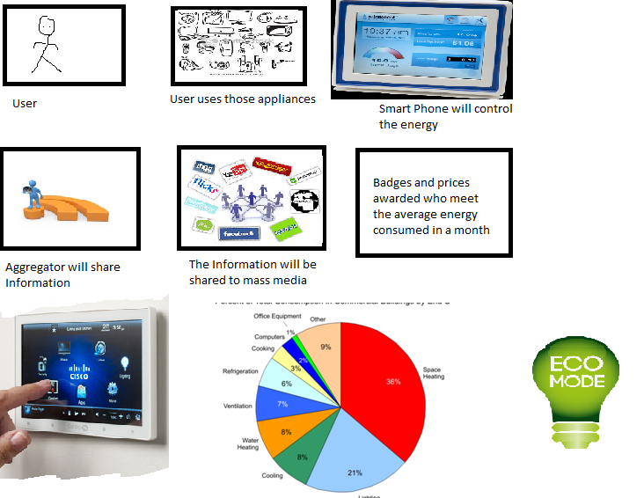
Storyboard or User Experience
The user walks in and put on the appliances or the sensor will automatically sense on and off the devices based on the location of users requirement. However, the user with his enabled smart phone the sensor data collected will be enabled to aggregator or agent for further processing in social media or to mobile users. The smart phone will automatically communicate to aggregator or directly to social media via through Internet. However for better and intelligent processing I have enabled all the sensor data to aggregator.
Explained Clearly on the Next Slide

Slide 9
Description of Storyboard or User Experience
  Step No.1 The Smart Phone acts here like embedded system. The smart phone is installed with software to monitor the level of energy consumed by each appliances, further the Hardware/Assembly language will be installed in the smart phone to communicate with the sensor integrated in respective appliances. The energy level consumed by each appliances will be effectively management by the smart phone as per the requirement of household need. The smart phone will have a usb port option or via wireless to connect to the appliances to communicate each other. The menu options of system and smart phone is very user friendly to use -ergonomics
  Step No.2 . The sensor chips are installed in respective appliances particularly the energy consumption rate and then then sensor data will be enabled in Smart Phone for further monitor and maintain the energy consumption rate automatically.
  Step No.3. The software installed in the Smart Phone will have an access to auto-control the usage of energy as per the need of appliances and the sensor data invoked from appliances will be enabled to Aggregator automatically for further processing. – Heuristic Principle will be implemented.
  Step No.4 However the data collected from Smart Phone is enabled to the Aggregator –the aggregator integrated with embedded system will further processes and make information available to all the interested users and alert them to reduce the usage of energy (Its communicated via through Internet –HTTP). Whereby the information is readily made available to most of the end users particularly in a social media to create awareness amongst friends or in mobile devices too.

Slide 10
Storyboard or User Experience
  Step No.5. The aggregator/agent will do further mapping and calculating of data which will be then shared to end users. The energy consumption rate will be shared in Face book or mobile devices to compare with friends so that we minimize the energy consumption rate.
  Step No.6. To alert interest of friends about the energy consumption rate the game option will be enabled where those friends who beat to meet the average energy consumed at home will be awarded badges or prices. [Face book or Foursquare]
  Step No.7. You can remotely view the real data of your household devices through mobile phone connected to Aggregator or web.
  Step No.8. Even the smart phone can monitor and control the household appliances energy consumption remotely with graphical view
  Maintain green power : The energy consumption rate is efficiently controlled by users at home when smart phone and sensor devices are enabled. The smart phone will enable the sensor data to Aggregator to process further, hence the information is more effectively made available via through mobile devices or social networking technology/Internet enabled services to region and friends.
  Note :
  1. The Internet is working out-door and indoor –with wireless/wi-max option
  2. The user can click to the Help Menu to use the functional working system of devices and application.

Slide 11
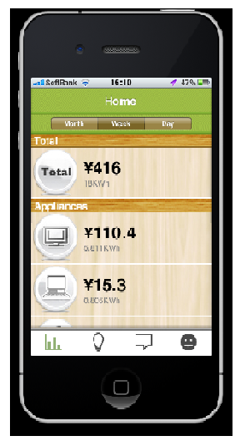
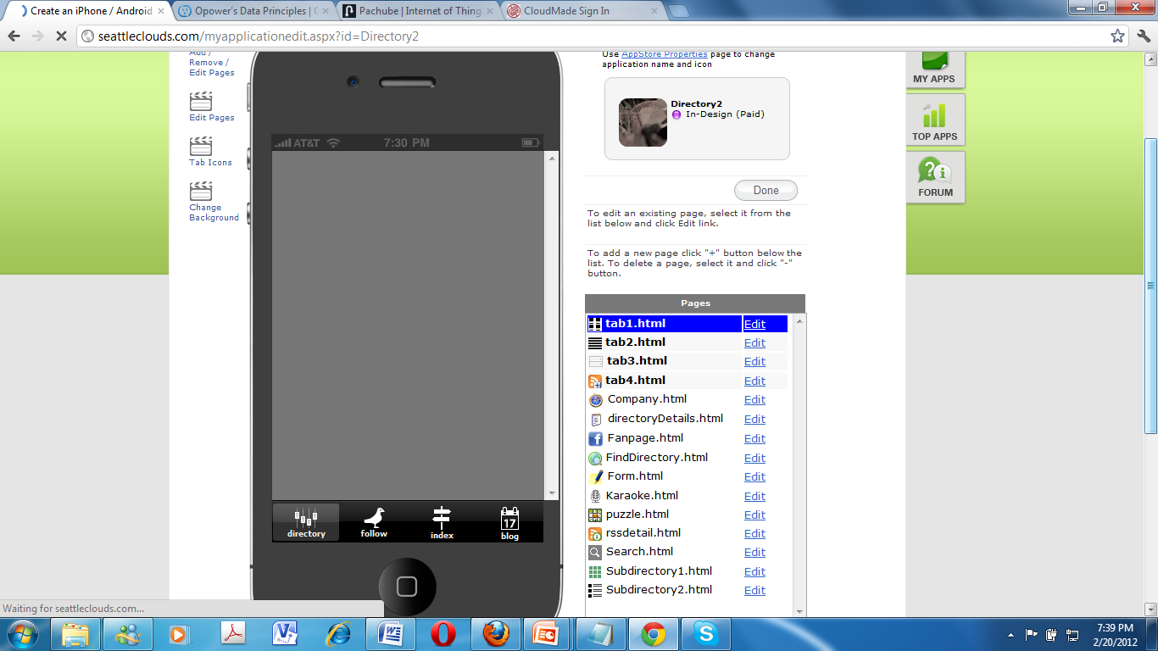
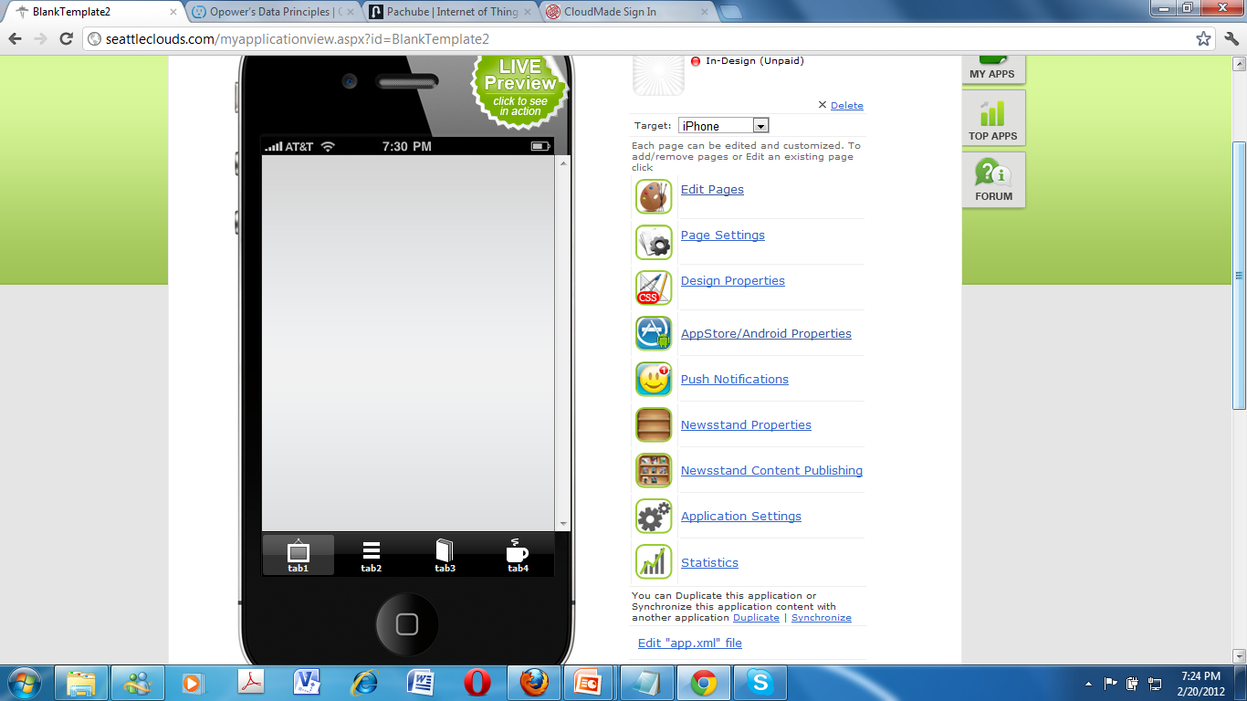
Aggregator Mock up of the Application
The mobile device will fetch data from Aggregator . The aggregator will fed the information of calculated energy consumed by Household.
Menu
Help ?
Location of Household
The smart phone will enable the sensor data to .Aggregator ,with its inbuilt embedded system the energy consumed by household will be calculated and then the information will be made accessible to all mobile users
Energy Consumed
Energy Consumed recently
Cost of Energy Consumed
Notify Message
Energy Saved
Location enabled
The Aggregator acts like an agent to make data accessible to any mobile users. The Aggregator with enabled embedded system will calculates the sensor data fetched from a smart phone that does mapping and graph in real time data and make information available to mobile users anywhere, at anytime via through Internet. The aggregator also will make the data available to smart phone too, nonetheless the same task can be done by smart phone too also. The one can even trace the real time data through your mobile device remotely and check the real time data of your energy consumption at home.

Slide 12
Process to encourage users to participate?
Facebook App
• Fund by organization or environment agencies – to alert and motivate friends
– To create awareness to the public the motto is to save energy consumption at home cost & save better environment using smart appliances.
•Reward points according to how much energy you saved and how many friends have responded to your invitation.
• Ranks participant according to points and save it every hourly or daily.
– Top Rank 50-100%
– Middle Rank 10-50%
– Lower Rank 0-10%
• Invite friends to participate and display them how much you’ve been able to
save to encourage friends
•Notify the best winner of badge on energy amongst your friends
• Invite friends to compare savings and show the stacks of game

Slide 13
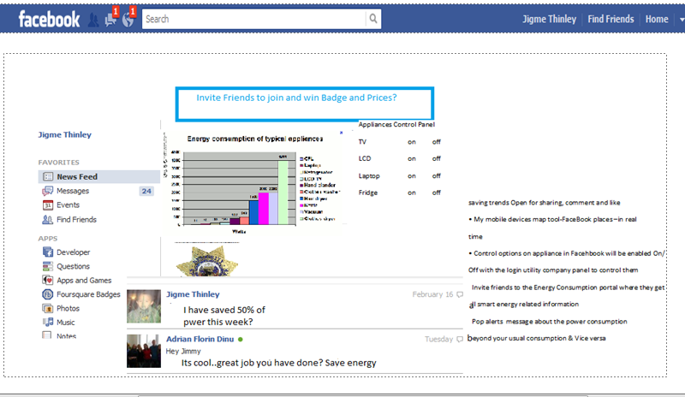
Integrate into Social Media

Slide 14
Conclusion
The System was designed using iPhone platform in external usage and in Household appliances monitoring the Smart Phone was used. The smart can remotely monitor the house appiances.
User can download and install an application
The energy consumption and control task was processesed by Aggregator on realtime . The calculation can be displayed in sum of hourly, a day(s), week(s) and month(s) and make those information available to social media or respond back to Smart Phone and in similar way smart phone can also do that same task like Aggregator.
The mobile users can even trace their real time data remotely or they will be notified with the message about the energy consumption rate.
The aggregator has integrated inbuilt embedded system to communicate with the sensor data of Smart phone and other external devices
All the household appliances have inbuilt sensor chips to communicate with smart phone – The smart phone will have assembly or machine langauge to communicate with those sensor chips
The energy consumption of household was monitored and effectively controlled by smart phone as per ones need.
The information to maintain energy consumption level amongst friends are easily wide spread though mobile devices and social media.
The game option is enabled in Foursquare site has really encouraged friends to share their energy consumption rate to win the badges and prices. Therefore this kind of mechansim has made to implement my project very sucessfully – in other words its brought a mass impact on the public to lower the consumption of energy at home.

Slide 15
References
  Opower.com
  Pachube.com
  www.youtube.com/watch?v=WUX$JLo6jUo
  urbanecomap.org/
  www.pcmag.com/article2/0,2817,2395108,00.asp

